Slide 1
📊Zomato Data Analytics
Insights on Restaurant Trends, Customer Preferences, and Business Performance

Slide 2


❓ Problem Statement
Zomato operates across multiple countries, offering diverse cuisines, booking options, and delivery services. However, business growth requires:
Understanding restaurant distribution across regions.
Tracking opening trends over years, months, and financial quarters.
Identifying customer preferences
(ratings, cuisines, bookings, online
delivery).
The challenge is to analyze Zomato’s
restaurant data to uncover actionable
insights that improve customer experience,
market strategies, and business expansion
plans.

Slide 3
🧩 Steps Taken to Solve the Problem
1. Build a Country Map Table
Extracted country codes from the dataset.
Mapped each code to its respective country name.
Created a reference table for use in joins and dashboards.
2. Build a Calendar Table using Datekey
Generated a calendar dimension to standardize time- based analysis.

Slide 4
Year → Extracted using YEAR(Datekey).
Month Number → MONTH(Datekey).
Month Full Name → DATENAME(MONTH, Datekey) / DATE_FORMAT.
Quarter → CEIL(MonthNo/3).
YearMonth → Concatenated Year & Month (e.g., 2017-Jan).
Weekday No → DAYOFWEEK(Datekey).
Weekday Name → DAYNAME(Datekey).
Financial Month → Logic: April = FM1 … March = FM12.
Financial Quarter → Grouped based on financial month buckets.
3. Find the Number of Restaurants by City & Country
Joined the Restaurant Table with Country Map Table.
Counted restaurants using COUNT(Restaurant_ID).
Aggregated results at city & country levels.

Slide 5
4. Number of Restaurants Opened by Year, Quarter, Month
Used Calendar Table linked with opening date.
Aggregated counts based on Year → Quarter → Month hierarchy
5. Count of Restaurants Based on Average Ratings
Grouped restaurants by rating range.
Counted how many fall into each rating.
Useful to see quality distribution.
6. Create Buckets Based on Average Price
Defined price ranges (e.g., Low, Medium, High, Premium).
Used CASE WHEN to classify restaurants.
Counted restaurants in each bucket.
7. % of Restaurants with Table Booking
Calculated (Restaurants with Table Booking / Total Restaurants) × 100.
Displayed percentage to understand service adoption.

Slide 6
8. % of Restaurants with Online Delivery
Similar approach as Table Booking.
Measured how many restaurants adopted delivery service.
9. Develop Charts Based on Cuisines, City, Ratings
Built visualization dashboards:
Top cuisines by count
City-wise restaurant distribution
Ratings distribution charts
Used bar, line, and pie charts for insights.

Slide 7
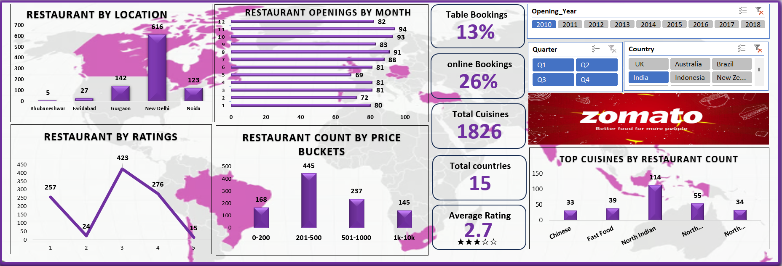
Excel:

Slide 8
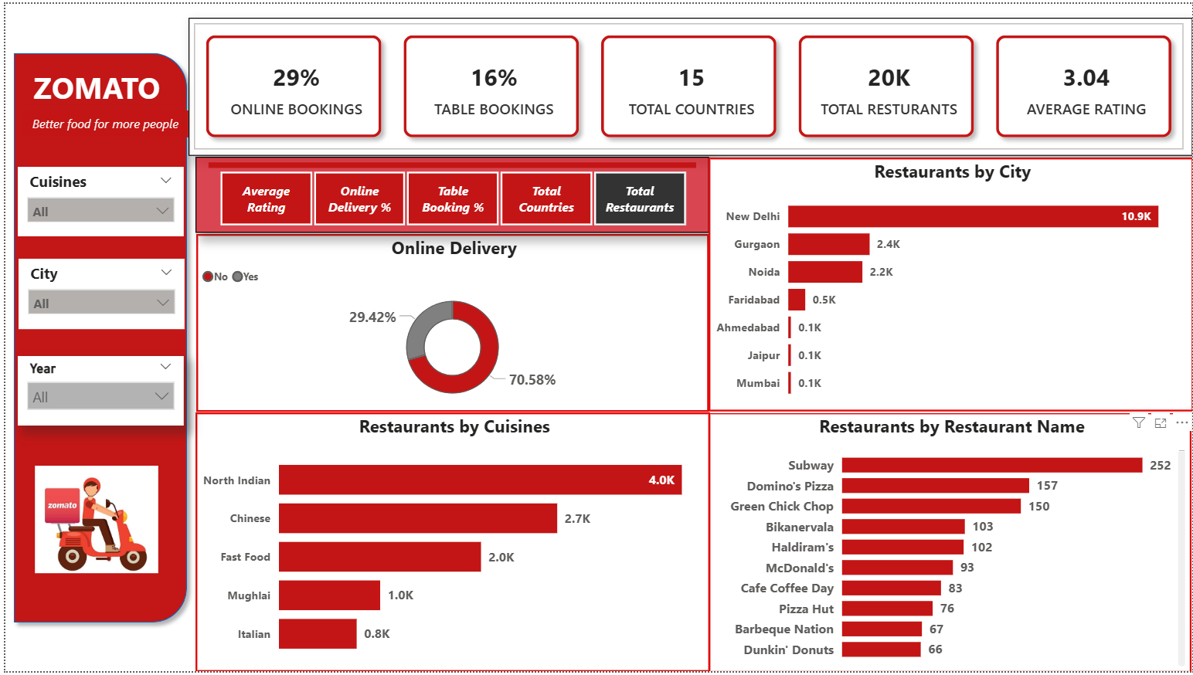
PowerBI:

Slide 9
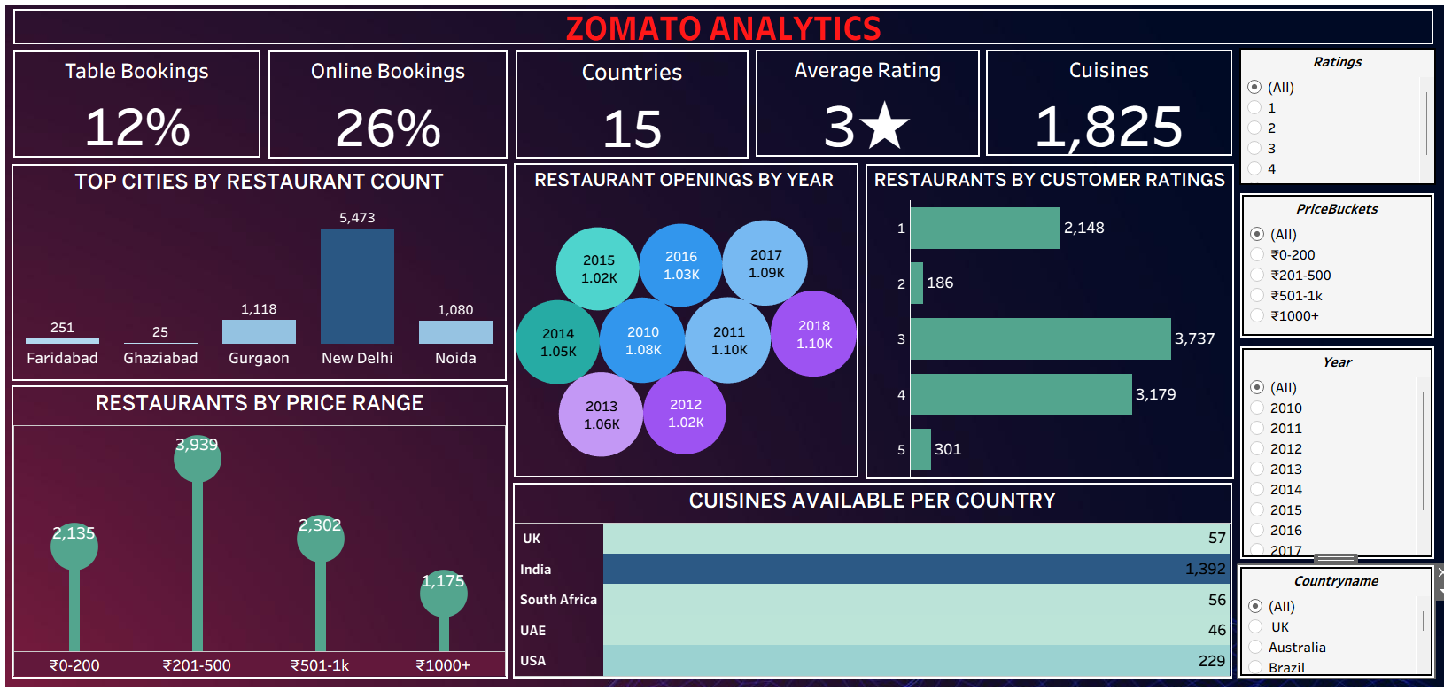
Tableau:

Slide 10
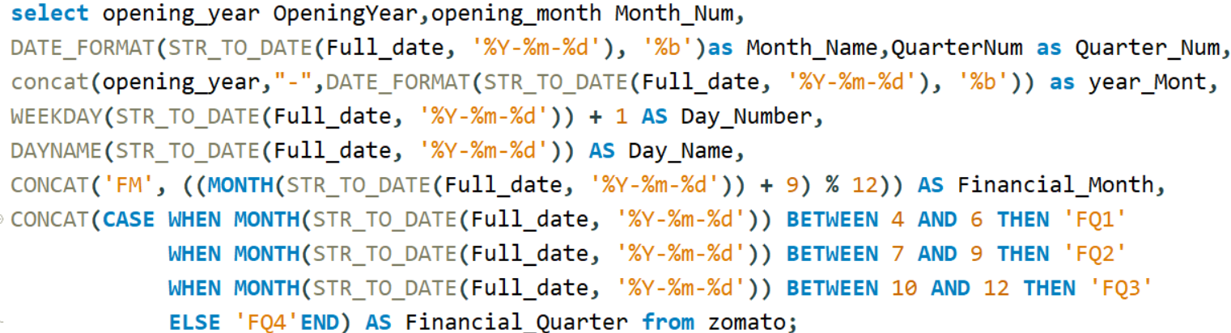
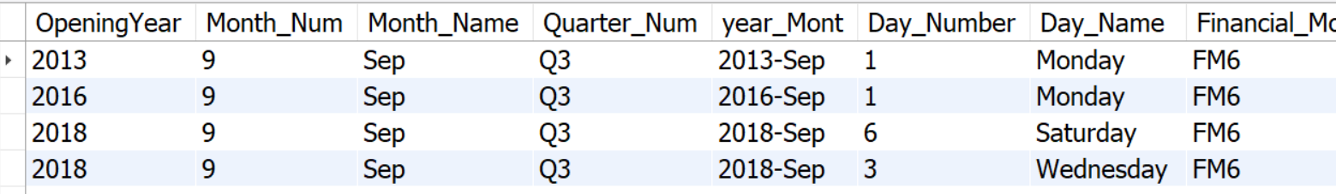
MySQL:
Build a Calendar Table using the Column Datekey.

Slide 11

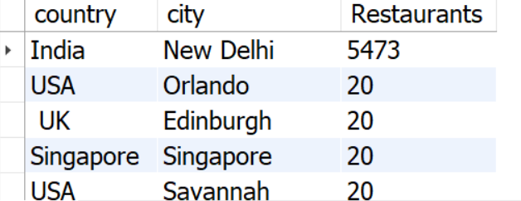

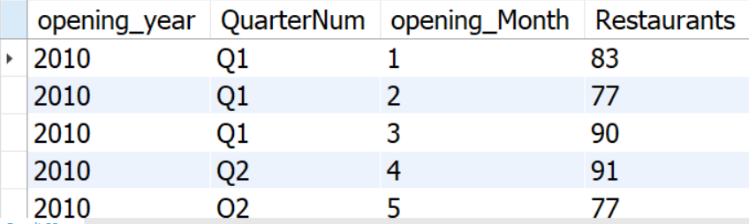
Find the Numbers of Resturants based on City and Country.
Numbers of Resturants opening based on Year,Quarter,Month.

Slide 12

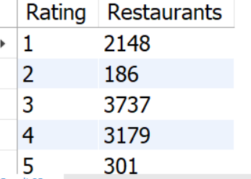

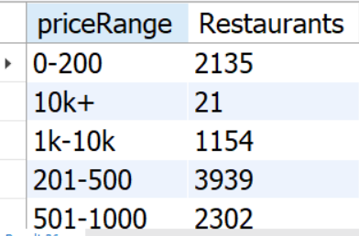
Count of Resturants based on Average Ratings.
buckets based on Average Price

Slide 13

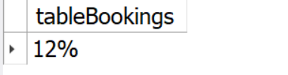

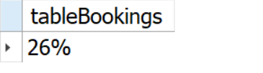

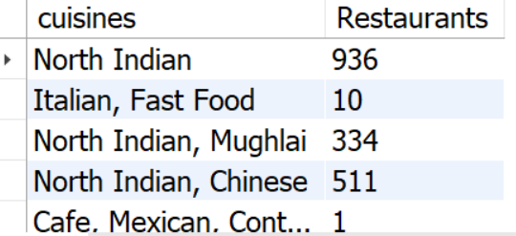
Percentage of Resturants based on "Has_Table_booking".
Percentage of Resturants based on "Has_Online_delivery".
Count of Restaurants based on cuisines

Slide 14
✅ Conclusions
New Delhi, Gurgaon, and Noida dominate in terms of restaurant presence.
Most restaurant openings happened steadily across years, with notable growth between 2010–2018.
Average customer ratings are around 3 stars, showing scope for service improvement.
Price ranges ₹201–500 host the majority of restaurants, highlighting customer affordability preference.
Only 12% restaurants offer table bookings and 26% offer online delivery, suggesting limited adoption of digital conveniences.

Slide 15
Recommendations
Boost Online Delivery & Table Booking: Encourage restaurants to adopt online systems to increase convenience and revenue.
Focus on High-Growth Cities: Allocate resources to New Delhi, Gurgaon, and Noida while also expanding in underrepresented cities.
Enhance Customer Ratings: Implement training & quality checks to improve customer satisfaction and push ratings towards 4–5 stars.
Cuisines Strategy: Promote diverse cuisines in regions with limited availability to attract broader audiences.

Slide 16
Thank You

